Slide 1


Name:G.v.Sasanka
Date:22-04-2024
https://github.com/sashanka74

Slide 2

Outline
Executive Summary
Introduction
Methodology
Results
Visualization –Charts
•Discussion
• Findings & Implications
•Conclusion •Appendix

Slide 3
Executive Summary
Data Collection & Preparation: ➢Utilized public SpaceX API and Wikipedia page. ➢Created 'class' column for successful landing classification. ➢Explored data using SQL, visualization, Folium maps, and dashboards. ➢Selected relevant features for machine learning.
2. Data Preprocessing: ➢Applied onehot encoding to categorical variables. ➢Standardized data for uniform scale. ➢Optimized model parameters using GridSearchCV.
3. Machine Learning Models: Developed models: ✓ Logistic Regression ✓ Support Vector Machine ✓ Decision Tree Classifier ✓ K Nearest Neighbors Achieved consistent accuracy (~83.33%).
4. Evaluation & Analysis: ➢Models tended to over predict successful landings. ➢Identified need for more data to enhance accuracy.
5. Model Performance Visualization: ➢Visualized accuracy scores to compare model performance.

Slide 4
Introduction
Background:
▪ Commercial space age is booming.
▪ SpaceX offers competitive pricing ($62M vs. $165M USD) due to rocket recovery.
▪ Space Y aims to rival SpaceX.
Problem: Stage 1 recovery. Approach:
❑ Space Y seeks a machine learning model to predict successful
▪ Data collection from SpaceX API and industry sources.
▪ Preprocess data and engineer features.
▪ Train ML models: logistic regression, SVM, decision trees

Slide 5
Methodology
1.Data Collection:
▪ Combined data from SpaceX API and Wikipedia.
2. Data Wrangling:
▪ Cleaned and organized collected data.
3. Classification:
▪ Identified successful and unsuccessful landings.
4. Exploratory Data Analysis (EDA):
▪ Used visualization and SQL for insights.
▪ Visualized data distribution.
▪ Extracted insights with SQL.
5. Interactive Visual Analytics:
▪ Employed Folium and Plotly Dash.

Slide 6
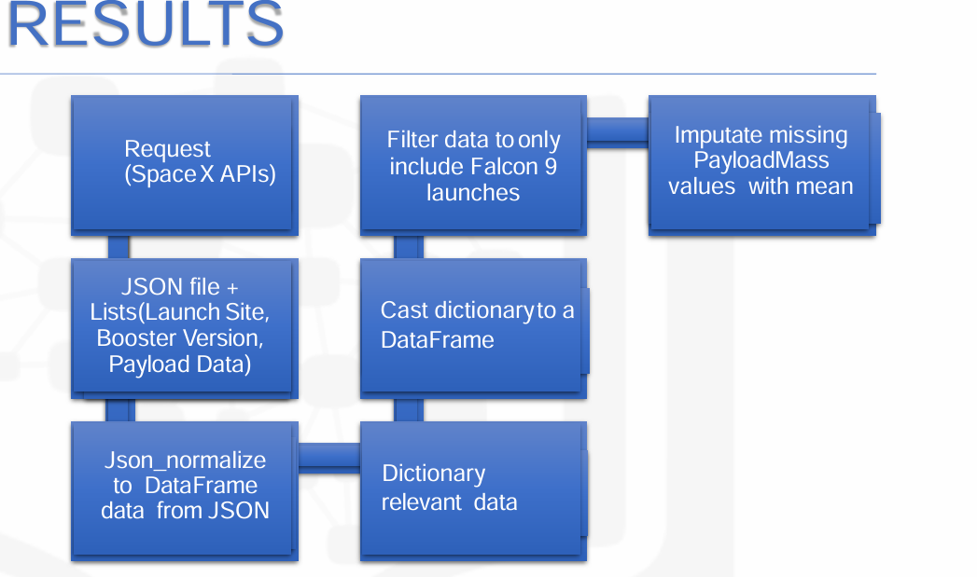
Data Collection

Slide 7
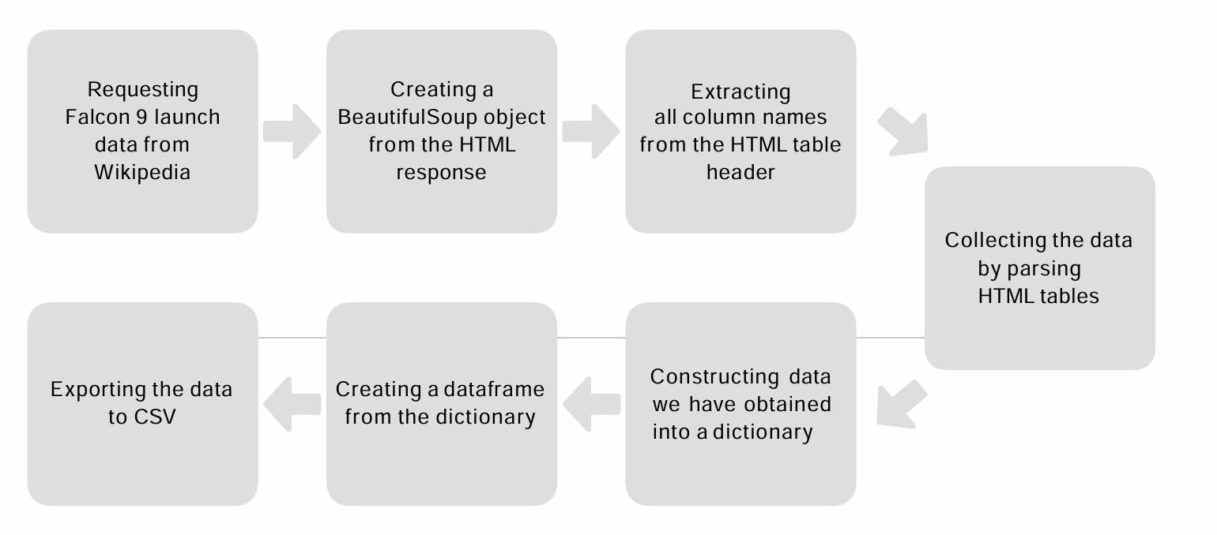
Data Collection – SpaceX API

Slide 8
EDA with Data Visualization
EDA with visualization offers insights into data characteristics, aiding in decision-making and hypothesis generation.
Visualizations help identify patterns, trends, outliers, and dependencies, enhancing data understanding.
Findings guide subsequent analysis and modeling, interpretability and robustness of results.
GitHub Link:https:/edx/jupyter-labs-EDA-with-Visualization-lab-venkatasashank.ipynb

Slide 9
EDA with SQL
Utilized SQL queries to perform comprehensive exploratory data analysis (EDA), extracting valuable insights directly from the dataset.
SQL facilitated efficient querying, aggregation, and manipulation of data, enabling in-depth analysis of various aspects such as distribution, relationships, trends, and outliers.
The EDAwith SQL provided a solid foundation for understanding the dataset's characteristics and informing subsequent analytical decisions.
GitHub Link:-https:/edx/jupyter-labs-eda-sql-edx_sqllite-venkatasashank.ipynb

Slide 10
Build an Interactive Map with Folium
Utilized Folium, a Python library for creating interactive maps, to perform geospatial analysis and visualization of data. Popup information windows were incorporated to display additional details when users interacted with map markers, enhancing data exploration. Interactive features such as zooming, panning, and toggling layers were integrated to provide users with a dynamic and
GitHub Findings:
Map Generation
Marker Clustering
Popup Information
Github Link:-https:/edx/jupyter-labs-Interactive-Visual-Analytics-with-Folium-lab-venkatasashank.ipynb

Slide 11
Build a Dashboard with Plotly Dash
The Interactive Dashboard built with Plotly Dash offers a dynamic and user-friendly interface for exploring and visualizing data.
Data Visualization:
Implemented interactive charts and graphs using Plotly to visualize key insights and trends. User Interaction:
Included line charts, bar charts, scatter plots, and heat maps to represent different aspects of the data.
Integrated dropdown menus, sliders, and date pickers to enable users to filter and customize the displayed data dynamically.
GitHub Link:-https:/PlotyDash-venkatasashank.ipynb
GitHub Link:.

Slide 12
Predictive Analysis (Classification)
The Machine Learning Prediction Lab is dedicated to developing and evaluating predictive models using advanced machine learning techniques.
Model Evaluation:
Employed cross-validation techniques to assess model generalization and robustness.
Identified key factors influencing the target variable based on feature importance analysis.
GitHub Link:-https:/edx/jupyterlite-venkatasashank.ipynb

Slide 13
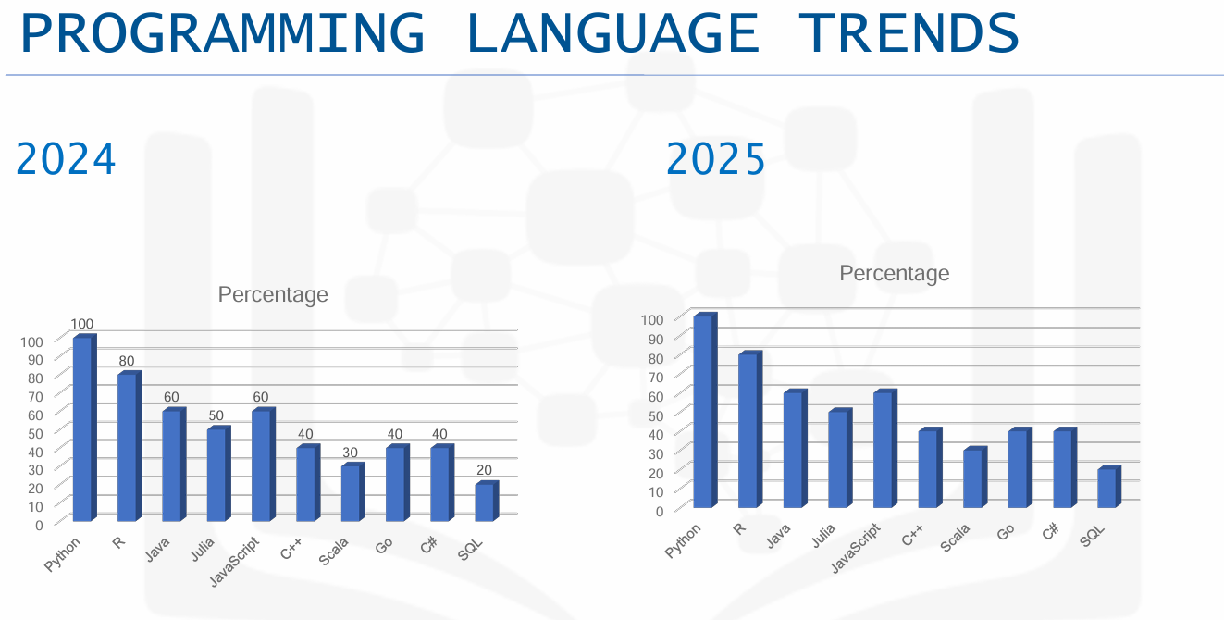
Results

Slide 14
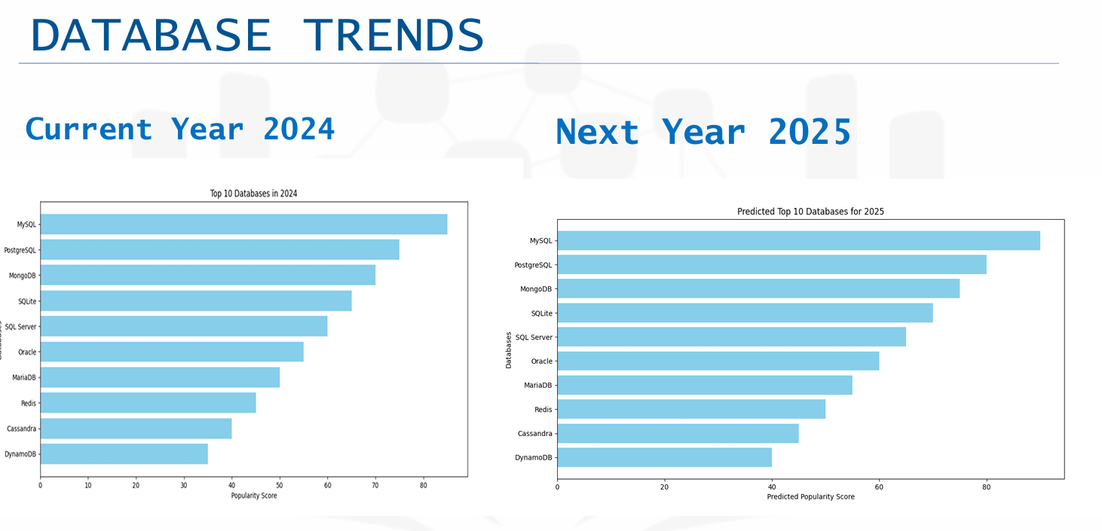
Flight Number vs. Launch Site

Slide 15
All Launch Site Names
Findings
Finding1:Relational databasessuchas MySQLandPostgreSQLcontinue tobe widely adopted for traditional data management tasks due to their robustnessandstability.
Finding 2: NoSQL databases like MongoDB and Redis are gaining popularity for handling unstructured and semi-structured data, such as social media analytics and IoT applications.
• Embrace cloud-native databases and managed services to leverage the benefits of scalability, flexibility, and reduced maintenance overhead, enabling faster time-to-market and cost savings.
Implications
Organizations should maintain proficiency in relational databases to manage structured data effectively, particularly for legacy systems and traditional applications.
Consider adopting NoSQL databases for projects with requirements for handling diverse and rapidly changing data types, such as social media analytics and IoT applications..

Slide 16
Conclusions
•User-friendly interface and intuitive design enable easy creation and customization of dashboards, reducing the learning curve for users.
•Seamless data integration capabilities ensure access to comprehensive data from diverse sources,enhancingdataanalysisanddecision-making.
• Interactivevisualizationfeaturesempowerusers toexploredatadynamically,uncoveringinsights andtrendsthatdrivebusinessoutcomes.
•Robust collaborationandsharing functionalities facilitate teamwork and communication, fostering a data-driven culture within the organizationanddrivingcollectiveintelligenc

Slide 17


